Slide 1
Chapter 5
More Data Types and Operators
李晔锋

Slide 2
Key Skills & Concepts
Understand and create arrays
Create multidimensional arrays
Create irregular arrays
Know the alternative array declaration syntax
Assign array references
Use the length array member
Use the for-each style for loop
Work with strings
Apply command-line arguments
Use the bitwise operators
Apply the ? operator

Slide 3
Arrays
An array is a collection of variables of the same type, referred to by a common name.
In Java, arrays can have one or more dimensions, although the one dimensional array is the most common.

Slide 4
One-Dimensional Arrays
A one-dimensional array is a list of related variables. To declare a one-dimensional array, you can use this general form:
type array-name[ ] = new type[size];
Here is an example. The following creates an int array of 10 elements and links it o an array reference variable named sample:
int sample[] = new int[10];
As with objects, it is possible to break the preceding declaration in two. For example:
int sample[];
sample = new int[10];

Slide 5
The Index（索引、下标） of an Array
An index describes the position of an element within an array.
In Java, all arrays have zero as the index of their first element.

Slide 6
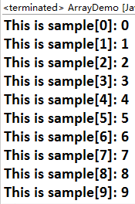
Array Demo
public class ArrayDemo {
public static void main(String[] args) {
// TODO Auto-generated method stub
int sample[] = new int[10];
int i;
for(i = 0; i < 10; i = i + 1)
sample[i] = i;
for(i = 0; i < 10; i = i + 1)
System.out.println("This is sample[" + i + "]: " +
sample[i]);
}
}

Slide 7
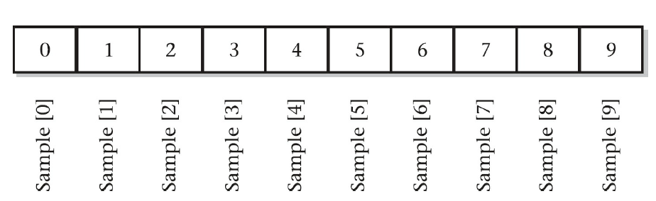
Data Stored in the Array

Slide 8
Min and Max Demo
public class MinMax {
public static void main(String[] args) {
// TODO Auto-generated method stub
int nums[] = new int[10];
int min, max;
nums[0] = 99;
nums[1] = -10;
nums[2] = 100123;
nums[3] = 18;
nums[4] = 978;
nums[5] = 5623;
nums[6] = 463;
nums[7] = -9;
nums[8] = 287;
nums[9] = 49;
min = max = nums[0];
for(int i = 1; i < 10; i++) {
if(nums[i] < min) min = nums[i];
if(nums[i] > max) max = nums[i];
}
System.out.println("min and max: " + min + " " + max);
}
}

Slide 9
Initialization of an One-Dimensional Array
Arrays can be initialized when they are created. The general form for initializing a one-dimensional array is shown here:
type array-name[ ] = { val1, val2, val3, ... , valN };

Slide 10
Improved Min and Max Demo
public class MinMax2 {
public static void main(String[] args) {
// TODO Auto-generated method stub
int nums[] = {99, -10, 100123, 18, -978,
5623, 463, -9, 287, 49};
int min, max;
min = max = nums[0];
for(int i = 1; i < 10; i++) {
if(nums[i] < min) min = nums[i];
if(nums[i] > max) max = nums[i];
}
System.out.println("min and max: " + min + " " + max);
}
}

Slide 11
Multidimensional Arrays
Although the one-dimensional array is the most commonly used array in programming, multidimensional arrays (arrays of two or more dimensions) are certainly not rare. In Java, a multidimensional array is an array of arrays.

Slide 12
Two-Dimensional Arrays
A two-dimensional array is, in essence, a list of one-dimensional arrays. To declare a two-dimensional integer array table of size 10, 20 you would write
int table[][] = new int[10][20];

Slide 13
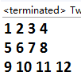
Two-Dimensional Array Demo
public class TwoD {
public static void main(String[] args) {
// TODO Auto-generated method stub
int t,i;
int table[][] = new int [3][4];
for(t = 0; t < 3; ++t) {
for(i = 0; i < 4; ++i) {
table[t][i] = (t * 4) + i + 1;
System.out.print(table[t][i] + " ");
}
System.out.println();
}
}
}

Slide 14
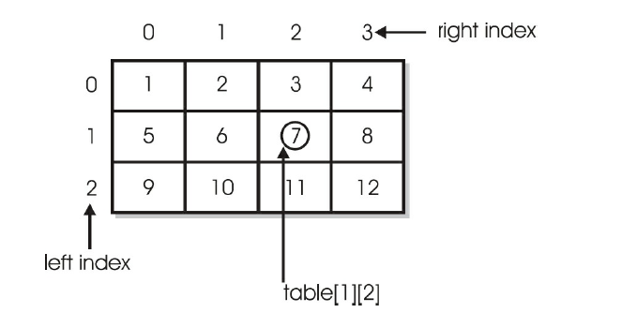
Two-Dimensional Array Demo

Slide 15
Irregular Arrays
When you allocate memory for a multidimensional array, you need to specify only the memory for the first (leftmost) dimension. You can allocate the remaining dimensions separately.
int table[][] = new int[3][];
table[0] = new int[4];
table[1] = new int[3];
table[2] = new int[2];
0
1
2
3
0
1
2

Slide 16
Improved Riders Demo
int i, j;
int riders[][] = new int[7][];
for(i = 0; i < 5; i++)
riders[i] = new int[10];
for(i = 5; i < 7; i++)
riders[i] = new int[2];

Slide 17
Arrays of Three or More Dimensions
Java allows arrays with more than two dimensions. Here is the general form of a multidimensional array declaration:
type name[ ][ ]...[ ] = new type[size1][size2]...[sizeN];
For example, the following declaration creates a 4 × 10 × 3 three-dimensional integer array.
int multidim[][][] = new int[4][10][3];

Slide 18
Initializing Multidimensional Arrays
type-specifier array_name[][] = {
{val, val, val, …, val},
{val, val, val, …, val},
{val, val, val, …, val},
…
{val, val, val, …, val}
}

Slide 19
Alternative Array Declaration Syntax
There is a second form that can be used to declare an array:
type[ ] var-name;
The following declarations are also equivalent:
int counter[] = new int[3];
int[] counter = new int[3];
The following declarations are also equivalent:
char table[][] = new char[3][4];
char[][] table = new char[3][4];
The following declarations are also equivalent:
int nums[], nums2[], nums3[];
int[] nums, nums2, nums3;

Slide 20

Output an Array
You can use Arrays.toString() to retrieve the String contents of an array.
It is required to import java.util.Arrays.
import java.util.Arrays;
public class PrintArray {
public static void main(String[] args) {
// TODO Auto-generated method stub
int[] a = {2, 3, 5, 7, 11, 13};
char[][] b = {
{'a','b','c','d'},{'e','f’}
};
System.out.println(Arrays.toString(a));
System.out.println(Arrays.toString(b[0]));
System.out.println(Arrays.toString(b[1]));
}
}

Slide 21
Assigning Array References
When you are assigning an array variable to another, you are not making the copy of it, instead, the reference is assigned. For example:
int a[] = {1, 2, 3, 4, 5};
int b[] = {-1, -2, -3, -4, -5};
b = a;
Now b is referred to a sharing the same memory address.
a
1
2
3
4
5
b
-1
-2
-3
-4
-5

Slide 22
public class AssignARef {
public static void main(String[] args) {
// TODO Auto-generated method stub
int i;
int nums1[] = new int[10];
int nums2[] = new int[10];
for(i = 0; i < 10; i++) {
nums1[i] = i;
nums2[i] = -i;
}
System.out.println("Here is nums1: " + Arrays.toString(nums1));
System.out.println("Here is nums2: " + Arrays.toString(nums2));
nums2 = nums1;
System.out.println("Here is nums2 after assignment: " + Arrays.toString(nums2));
//now operate on nums1 array through nums2
nums2[3] = 99;
System.out.print("Here is nums1 after change through nums2: ");
System.out.println(Arrays.toString(nums1));
}
}

Slide 23
Using the length Member
Because arrays are implemented as objects, each array has associated with it a length instance variable that contains the number of elements that the array can hold.

Slide 24
The length Demo
public class LengthDemo {
public static void main(String[] args) {
// TODO Auto-generated method stub
int list[] = new int[10];
int nums[] = {1,2,3};
int table[][] = {{1,2,3},{4,5},{6,7,8,9}};
System.out.println("length of list is " + list.length);
System.out.println("length of nums is " + nums.length);
System.out.println("length of table is " + table.length);
System.out.println("length of table[0] is " + table[0].length);
System.out.println("length of table[1] is " + table[1].length);
System.out.println("length of table[2] is " + table[2].length);
System.out.println();
//use length to initialize list
for(int i = 0; i < list.length; i++)
list[i] = i * i;
System.out.println("Here is list: " + Arrays.toString(list));
}
}

Slide 25
Use length Variable to Copy an Array
public class ACopy {
public static void main(String[] args) {
// TODO Auto-generated method stub
int i;
int nums1[] = new int[10];
int nums2[] = new int[10];
for(i = 0; i < nums1.length; i++)
nums1[i] = i;
//copy nums1 to nums2
if(nums2.length >= nums1.length)
for(i = 0; i < nums1.length; i++)
nums2[i] = nums1[i];
System.out.println(Arrays.toString(nums2));
}
}

Slide 26

Other Array Copy Approaches
System.arraycopy(sourceArray, int index1, destArray, int index2, int length)
Copy the data from the index1 of sourceArray to replace the data from index2 of destArray with the length of length.
public class ACopy1 {
public static void main(String[] args) {
// TODO Auto-generated method stub
int nums1[] = {1,2,3,4,5,6};
int nums2[] = {-1,-2,-3,-4,-5,-6};
System.arraycopy(nums1, 1, nums2, 2, 3);
System.out.println(Arrays.toString(nums2));
}
}

Slide 27
Other Array Copy Approaches
Arrays.copyOf(sourceArray, int newLength)
Copy the source array to a new array with length of newLength.
Arrays.copyOfRange(sourceArray, int from, int to)
Copy the source array to a new array, with index from from to to-1.

Slide 28

public class ACopy2 {
public static void main(String[] args) {
// TODO Auto-generated method stub
int nums1[] = {1,2,3,4,5,6};
int[] nums2, nums3;
nums2 = Arrays.copyOf(nums1, 8);
nums3 = Arrays.copyOfRange(nums1, 1,4);
System.out.println("nums2: " + Arrays.toString(nums2));
System.out.println("nums3: " + Arrays.toString(nums3));
}
}

Slide 29
The For-Each Style for Loop
There’s another style of for loop, the general form is shown as follows:
for(type itr-var : collection) statement-block
Here, type specifies the type, and itr-var specifies the name of an iteration variable that will receive the elements from a collection, one at a time, from beginning to end. The collection being cycled through is specified by collection.

Slide 30
Comparison Between Two for Styles
public class ForEach {
public static void main(String[] args) {
// TODO Auto-generated method stub
int nums[] = {1,2,3,4,5,6,7,8,9,10};
int sum1=0,sum2=0;
//The for-each style to calculate the sum value
for(int x: nums)
sum1 += x;
//The old style to calculate the sum value
for(int i = 0; i < nums.length; i++) {
int x = nums[i];
sum2 += x;
}
System.out.println("sum1: "+sum1+"sum2: "+sum2);
}
}

Slide 31
The For-Each for Style Loop
for(int x: nums)
sum1 += x;
The variable x must be compatible with the nums array
The variable x will loop from the beginning of nums array to its end.
You can break the loop using the same approach as the traditional style does.
The nums loop is read-only.

Slide 32
The Read-Only Feature
public class NoChange {
public static void main(String[] args) {
// TODO Auto-generated method stub
int nums[] = {1,2,3,4,5,6,7,8,9,10};
for(int x: nums) {
System.out.print(x + " ");
x = x * 10; //No effect on nums
}
System.out.println();
for(int x: nums)
System.out.print(x + " ");
System.out.println();
}
}

Slide 33
For-Each on Two-Dimensional Array
public class ForEach2 {
public static void main(String[] args) {
// TODO Auto-generated method stub
int sum = 0;
int nums[][] = new int[3][5];
//give nums some values;
for(int i = 0; i < nums.length; i++)
for(int j = 0; j < nums[i].length; j++)
nums[i][j] = (i+1) * (j+1);
//use for-each for loop to display and sum the values
for(int x[]: nums) {
for(int y: x) {
System.out.println("Value is: " + y);
sum += y;
}
}
System.out.println("Summation: " + sum);
}
}

Slide 34
Applying the Enhanced for
public class Search {
public static void main(String[] args) {
// TODO Auto-generated method stub
int nums[] = {6,8,3,7,5,6,1,4};
int val = 5;
boolean found = false;
//Use for-each style for to search nums for val.
for(int x: nums) {
if(x == val) {
found = true;
break;
}
}
if(found)
System.out.println("Value found!");
}
}

Slide 35
Other Array Operations
Arrays.sort(array)
Sort the array. It does not return anything.
Arrays.binarySearch(array, value)
Search the value in the sorted array, return the index where the value resides. If not found, -1 is returned.

Slide 36
Other Array Operations
public class Search2 {
public static void main(String[] args) {
// TODO Auto-generated method stub
int nums[] = {6,8,3,7,5,6,1,4};
int val = 5;
int found = -1;
Arrays.sort(nums);
System.out.println("After sort: " + Arrays.toString(nums));
found = Arrays.binarySearch(nums, val);
System.out.println("Index of " + val + " is " + found);
}
}

Slide 37
Strings
String is one of the most important of Java’s data types, it defines and supports character strings.
In some other programming languages, a string is an array of characters. This is not the case with Java. In Java, strings are objects.

Slide 38
Constructing Strings
You can construct a String just like you construct any other type of object: by using new and calling the String constructor. For example:
String str = new String("Hello");
You can also construct a String from another String. For example:
String str = new String("Hello");
String str2 = new String(str);
Another easy way to create a String is shown here:
String str = "Java strings are powerful.";

Slide 39
The String Demo
public class StringDemo {
public static void main(String[] args) {
// TODO Auto-generated method stub
String str1 = new String("Java strings are objects.");
String str2 = "They are constructed various ways.";
String str3 = new String(str2);
System.out.println(str1);
System.out.println(str2);
System.out.println(str3);
}
}

Slide 40
Operations on Strings
boolean equals(str) | Returns true if the invoking string has exactly the same character sequence as str
boolean contains(str) | Returns true if the invoking string contains str
boolean startsWith(str) | Returns true if the invoking string starts with str
boolean endsWith(str) | Returns true if the invoking string ends with str
int length() | Obtains the length of a string
char charAt(index) | Obtains the character at the index specified by index.
int compareTo(str) | Returns a negative number if the invoking string is less than str, positive number if greater than str, zero if equal
int indexOf(str) | Searches the invoking string for the substring specified by str. Return the index of the first match or -1 on failure
int lastIndexOf(str) | Searches the invoking string for the substring specified by str. Return the index of the last match or -1 on failure
String trim() | Returns a new String without heading and tailing spaces.

Slide 41
The String Equals Demo
public class StringEquals {
public static void main(String[] args) {
// TODO Auto-generated method stub
String s1,s2;
s1=new String("天道酬勤");
s2=new String("天道酬勤");
System.out.println(s1.equals(s2));
System.out.println(s1==s2);
String s3,s4;
s3="勇者无敌";
s4="勇者无敌";
System.out.println(s3.equals(s4));
System.out.println(s3==s4);
}
}

Slide 42
The Special String Reference
The new operation can assign space for a String object in memory, thus two String objects with the same value resides in different memory address.
Otherwise, each string value has its unique address in the memory space.
s1=new String("天道酬勤");
s2=new String("天道酬勤");
s1
天道酬勤
s2
天道酬勤
s3
s3="勇者无敌";
s4="勇者无敌";
勇者无敌
s4

Slide 43
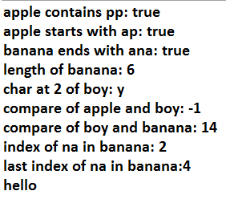
public class StrOps {
public static void main(String[] args) {
// TODO Auto-generated method stub
String str1 = "apple";
String str2 = "boy";
String str3 = "banana";
System.out.println("apple contains pp: " + str1.contains("pp"));
System.out.println("apple starts with ap: " + str1.startsWith("ap"));
System.out.println("banana ends with ana: " + str2.endsWith("ana"));
System.out.println("length of banana: "+ str3.length());
System.out.println("char at 2 of boy: " +str2.charAt(2));
System.out.println("compare of apple and boy: "+
str1.compareTo(str2));
System.out.println("compare of boy and banana: "+
str2.compareTo(str3));
System.out.println("index of na in banana: "+str3.indexOf("na"));
System.out.println("last index of na in banana:"+ str3.lastIndexOf("na"));
String str4 = " hello ";
System.out.println(str4.trim());
}
}

Slide 44
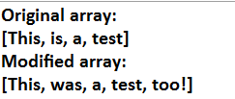
Arrays of Strings
Like any other data type, strings can be assembled into arrays.
public class StringArrays {
public static void main(String[] args) {
// TODO Auto-generated method stub
String strs[] = {"This","is","a","test"};
System.out.println("Original array: ");
System.out.println(Arrays.toString(strs));
//change a string
strs[1] = "was";
strs[3] = "test, too!";
System.out.println("Modified array: ");
System.out.println(Arrays.toString(strs));
}
}

Slide 45
Split a String
If a string is separated by a specific symbol, you can extract each substring using the split method. For example:
String str = “This is a test”;
String[] result = str.split(“ ”);
The split method returns an array of String that contains each substring.
However, the parameterized String that passed into the split method can be a single symbol, or a very complicated regular expression, that will not be introduced in this class.

Slide 46

Split Demo
public class SplitString {
public static void main(String[] args) {
// TODO Auto-generated method stub
String phone = "010-6237-4858";
String[] result = phone.split("-");
for(int i = 0; i < result.length; i++)
System.out.println(result[i]);
}
}

Slide 47
Strings Are Immutable
The contents of a String object are immutable. That is, once created, the character sequence that makes up the string cannot be altered.
When you need a string that is a variation on one that already exists, simply create a new string that contains the desired changes.

Slide 48

Usage of substring
The substring( ) method returns a new string that contains a specified portion of the invoking string. The form is shown here:
String substring(int startIndex, int endIndex)
It returns a new String from the index of startIndex to endIndex-1 of the original String.
public class SubStr {
public static void main(String[] args) {
// TODO Auto-generated method stub
String orgstr = "0123456789";
//construct a substring
String substr = orgstr.substring(3,7);
System.out.println("orgstr: " + orgstr);
System.out.println("substr: " + substr);
}
}

Slide 49
Using String to Control a switch Statement
public class StringSwitch {
public static void main(String[] args) {
// TODO Auto-generated method stub
String command = "cancel";
switch(command) {
case "connect":
System.out.println("Connecting");break;
case "cancel":
System.out.println("Canceling");break;
case "disconnect":
System.out.println("Disconnecting");break;
default:
System.out.println("Command Error!");break;
}
}
}

Slide 50
Using Command-Line Arguments
The command-line arguments can be passed to the “String [] args” parameter of the main method for further processing.
public class CLDemo {
public static void main(String[] args) {
// TODO Auto-generated method stub
System.out.println("There are " + args.length +
"command-line arguments.");
System.out.println("They are: ");
for(int i = 0; i < args.length; i++)
System.out.println("args[" + i + "]: " + args[i]);
}
}

Slide 51
Run Command-Line Arguments in Eclipse
Right click on the main class, select “Run as…” → “Run configurations”.
In the left panel of the popup dialog, find out the “Java Application” item, and double click on it. You will see the main class appeared in the right panel.
In the right panel, click the “Arguments” tab, and fill in the arguments in the “Program Arguments” textfield, and then click “Run”.

Slide 52
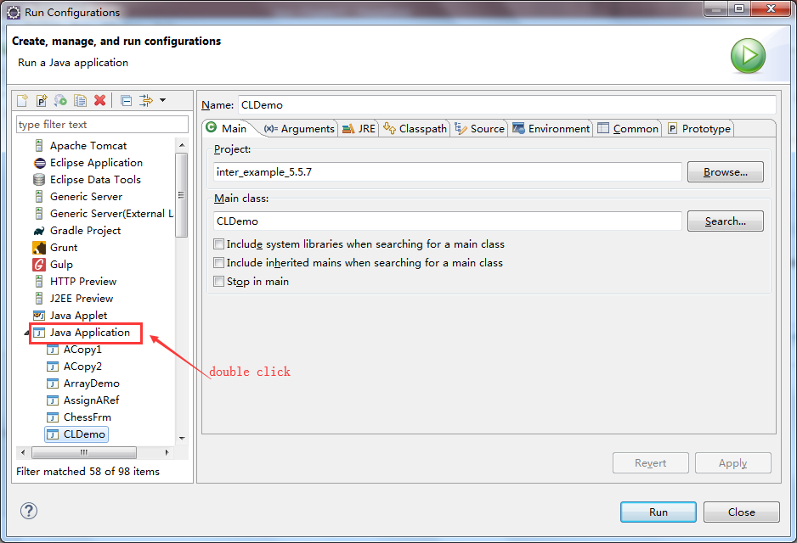
Run Command-Line Arguments in Eclipse

Slide 53
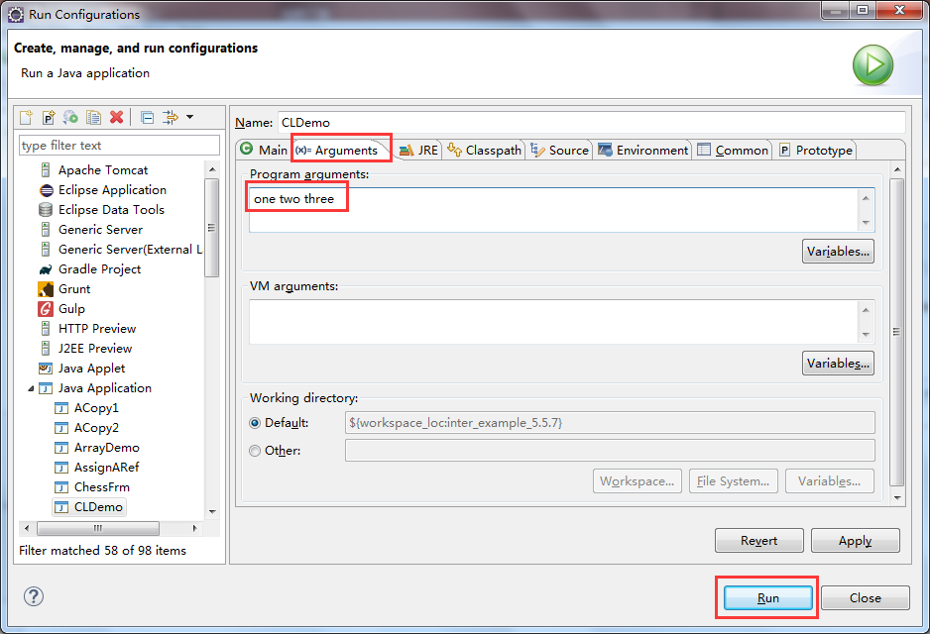
Run Command-Line Arguments in Eclipse

Slide 54
The Bitwise Operators
The bitwise operators can be used on values of type long, int, short, char, or byte. As they can be converted into the binary format.
The bitwise operators are related to the binary format, each “0” or “1” representing a bit.
For example:
(-86)₁₀ = (11010011)₂
(42)₁₀ = (00101010)₂

Slide 55
The Bitwise Operators
Operator | Result
& | Bitwise AND
| | Bitwise OR
^ | Bitwise exclusive OR
>> | Shift right（右移）
>>> | Unsigned shift right
<< | Shift left
~ | Complement（补码）

Slide 56
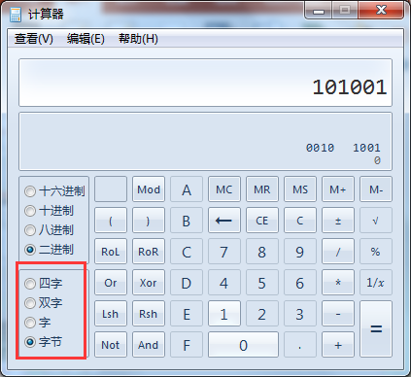
Using the Microsoft Calculator to Make Conversion Between Decimal and Binary
byte（字节）
short（字）
int（双字）
long（四字）

Slide 57
Manually Conversion From Decimal to Binary
2 |
53
—————
2 |
26 …………… 1
—————
13 ………… 0
2 |
————
6 ……… 1
2 |
———
3 ……… 0
2 |
———
1 ……… 1
2 |
———
0 ……… 1
(53)₁₀ = (110101)₂

Slide 58
Manually Conversion From Binary to Decimal
(110101)₂ = 1 * 2⁵ + 1 * 2⁴ + 0 * 2³
+ 1 * 2² + 0 * 2 + 1
= 32 + 16 + 4 + 1
= 53

Slide 59
The Symbol Bit
For each data type, the highest bit is called the symbol （符号位）. If the symbol is 0, then the number is positive, otherwise, it is negative. Take the previous example:
(-86)₁₀ = (11010011)₂
(42)₁₀ = (00101010)₂
The two numbers are byte (8 bits_, thus the symbol bit (in red) shows whether positive or negative.
If a number is unsigned, then the highest bit is considered as ordinary, rather than symbol, which means the number is always positive.

Slide 60
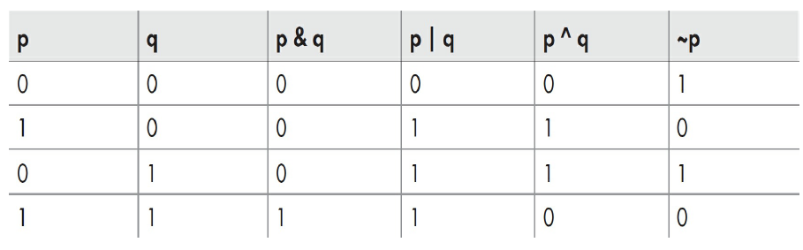
The Bitwise Operation Table

Slide 61
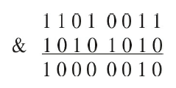
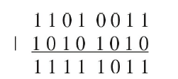
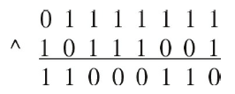
Bitwise Operation Samples
The bitwise operation is performed on each bit of the corresponding numbers.
~(11010011)
= 00101100

Slide 62

The Shift Operators
In Java it is possible to shift the bits that make up a value to the left or to the right by a specified amount. Java defines the three bit-shift operators shown here:

Slide 63
Bitwise Shorthand Assignments
All of the binary bitwise operators have a shorthand form that combines an assignment with the bitwise operation. For example, the following two statements both assign to x the outcome of an XOR of x with the value 127.
x = x ^ 127
x ^= 127

Slide 64
The ? : Operator
The ? operator is often used to replace if-else statements of this general form:
if(condition) var = expression1;
else var = expression2;
It can be used as:
var = condition ? expression1 : expression2;

Slide 65
The ? : Operator Example
import java.util.Scanner;
public class Question {
public static void main(String[] args) {
// TODO Auto-generated method stub
String result;
int input;
Scanner sc = new Scanner(System.in);
input = sc.nextInt();
result = input >=0 ? "Positive" : "Negative";
System.out.println("The result is: " + result);
sc.close();
}
}

